Slide 1
Musical Instrument Digital Interface
Miguel Cuéllar, Martín Castañeda, Alejandro Angulo & Mario Alberto Gómez

Slide 2
What is MIDI?
MIDI, or also better known by its abbreviation of Musical Instrument Digital Interface is a technological standard that is used to describe a protocol, a digital interface and connectors that allow various electronic musical instruments, computers and other related devices to connect and communicate with each other.
In other words, it's how electronic devices, such as synthesizers, samplers and/or computers, that perform music production and control sound can be connected to each other via MIDI messages.

Slide 3
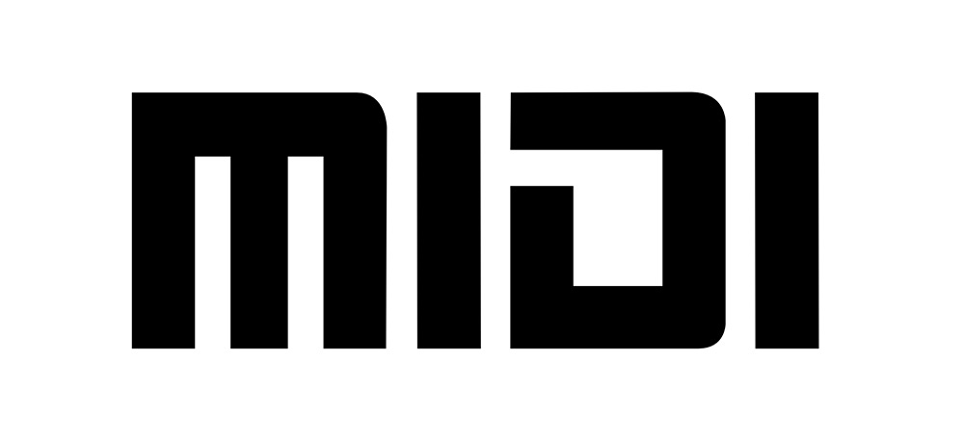
According to Experts
According to MIDI Manufacturers Association (MMA), "MIDI is an industry standard music technology protocol that connects products from many different companies including digital musical instruments, computers, tablets, and smartphones" (2019).

Slide 4
Why use MIDI?
The MIDI system carries event messages that specify musical notation, pitch, and speed signals that synchronize time between various devices. These messages are sent via a MIDI cable to other devices that control the generation of sounds. This data can also be recorded in a sequencer (like hardware or software) which allows you to edit the information and play it back later (Huber, 1991).
The advantages of using MIDI include its size because an entire song can be encoded in a few hundred lines, for example in a few kilobytes, and the easy manipulation, modification and selection of instruments.

